Slide 1
Onboarding demo
Ambarish V.C | Intern
07/06/2023

Slide 2
My learnings in the past 6 months
Key elements
C# basics and advanced concepts
Web API basics
Agile processes and methodologies and tools used.
Feature Driven Development process followed in SCIEX
SCIEX product and domain Knowledge
Certifications
Microsoft AZ-900 certified
AWS cloud practiotioner in progress

Slide 3
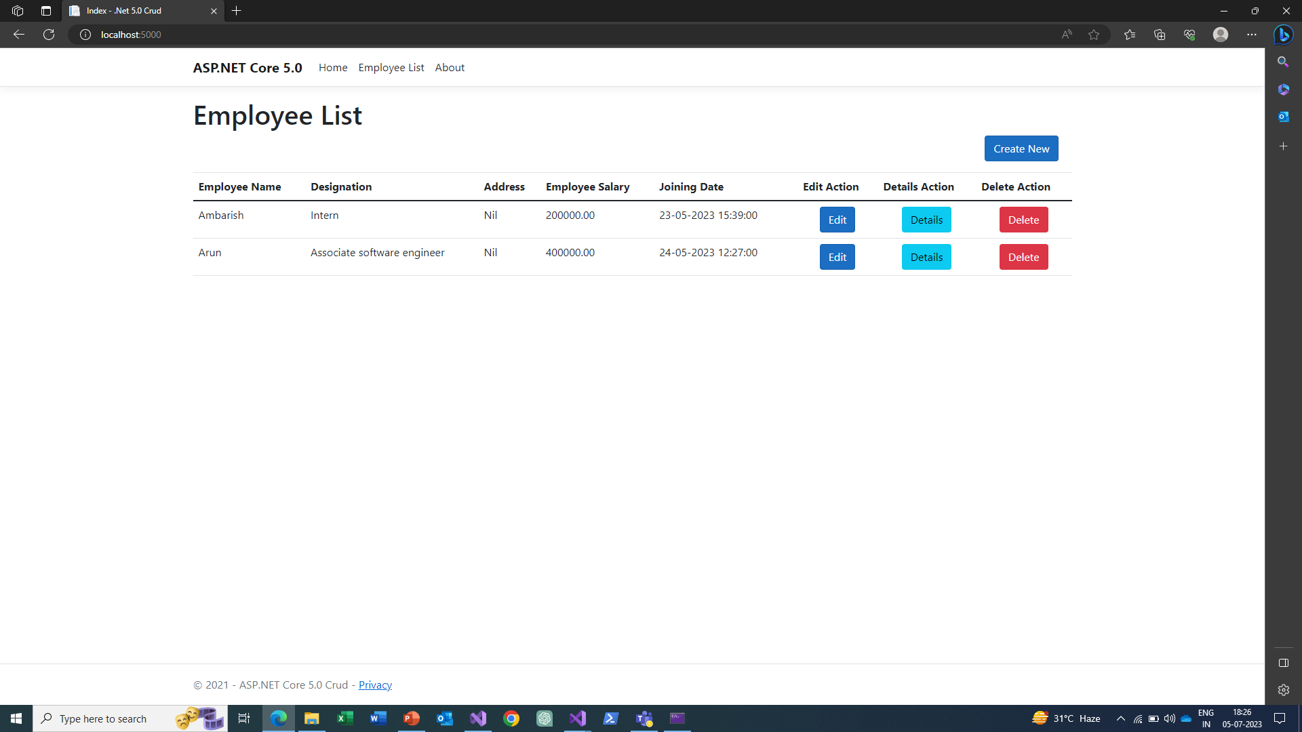
ASP.NET Core Web API
CRUD operations- simple project
Created a simple web application that performs CRUD operations using MVC Model.
It is an employee model that takes in user input and creates, reads, updates and deletes it in the database.
Tools used:
SQL Server
Visual Studio 2019
.NET 7 SDK
Here is an image of the web app:

Slide 4
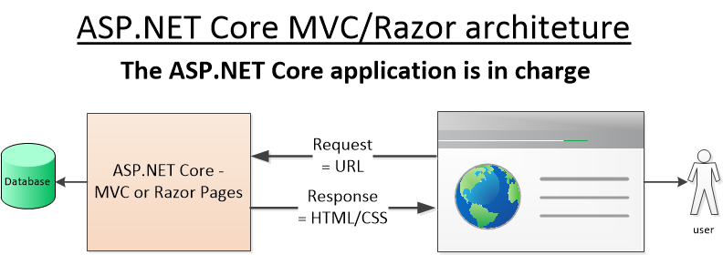
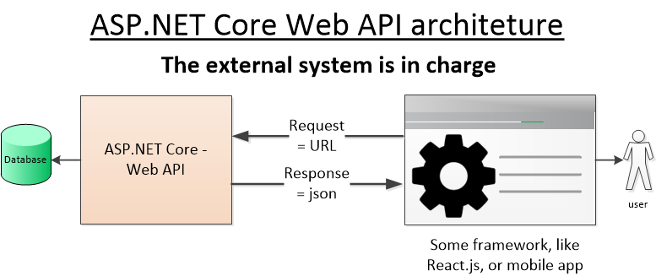
MVC Model
How it works?
There are now three main approaches to building a web application using ASP.NET Core:
NET Core MVC, which uses controllers, actions and views
NET Core Razor Pages, which has pages with associated code
NET Core Web API, which can be queried by a framework, like React.js, or an external system.
The first two have the ASP.NET Core web app deliver HTML pages, with the help of the built-in Razor syntax. In these cases, the ASP.NET Core web app is in charge of what is shown on the screen.
But in the ASP.NET Core Web API case what is shown to the user is controlled by something outside ASP.NET Core. For the human-user example its either framework (like AngularJS or React.js) or mobile application makes requests to the ASP.NET Core application to either get data or execute some business logic

Slide 5
Bachelor's degree - project Summary
ENHANCING CARDIOVASCULAR DISEASE PREDICTION USING HVT IN MACHINE LEARNING
Project description
The project is aimed to prognose the likelihood of a person prone to cardio-vascular diseases.
The application is a web application using technologies such as SQL Server, React JS for the front end and the prediction was done at the back end by an algorithm that uses RANDOM FOREST, DECISION TREES and K-nearest neighbour. 3000 sample data points were used and about 70% of them were used for training the model. 14 different parameters were used to arrive at a Risk index.
Application :
The application can be deployed at hospitals and chest clinics and cardiac care clinics to enable the physician to assess the patient
Team Size and My Role
4 members
Project management back -end application development and testing

Slide 6
Aspirations and Interest
Looking forward for a career in Healthcare
Keen to learn SW automation testing
SCIEX products and application Software that goes into the product
Long-term Interest Areas
Product Cybersecurity
Project Management skills
Pursue Postgraduate program in Cybersecurity.

Slide 7
Thank you

Slide 8
Trademarks / Licensing
The SCIEX clinical diagnostic portfolio is For In Vitro Diagnostic Use. Rx Only. Product(s) not available in all countries. For information on availability, please contact your local sales representative or refer to www.sciex.com/diagnostics. All other products are For Research Use Only. Not for use in Diagnostic Procedures.
Trademarks and/or registered trademarks mentioned herein, including associated logos, are the property of AB Sciex Pte. Ltd. or their respective owners in the United States and/or certain other countries (see www.sciex.com/trademarks).
© 2023 DH Tech. Dev. Pte. Ltd. DOC-XXX-XX-XXXX-X
Include Statements 2 - 6 below if there is use in document.
2. AB SCIEX™ is being used under license.
3. Beckman Coulter® is being used under license.
4. Echo and Echo MS are trademarks or registered trademarks of Labcyte, Inc. in the United States and other countries, and are being used under license.
Add the following statement if using images or animations of the clear box or 3D illustrations:
The images shown may be for illustration purposes only and may not be an exact representation of the product and/or the technology.
Add the following statement to indicate that plates are supplied by Beckman Coulter:
Plates are available from Beckman Coulter Life Sciences.
5. IntaBio® is being used under license.
6. Waters Empower™ software is being used under license.

